Slide 1
Hello World
My name : Yves Murhabazi
My project title : An interactive dashboard for school performance analysis using nation state exam result( EXETAT/DRC)
My Github username : Yvesmurh
edx usernames : yves25_4
My city : I'm congolese but currently living in Uganda/Kampala
The date I'm doing this is on the 27th December 2025

Slide 2
DATA …...

Slide 3
DASHBOARD....

Slide 4
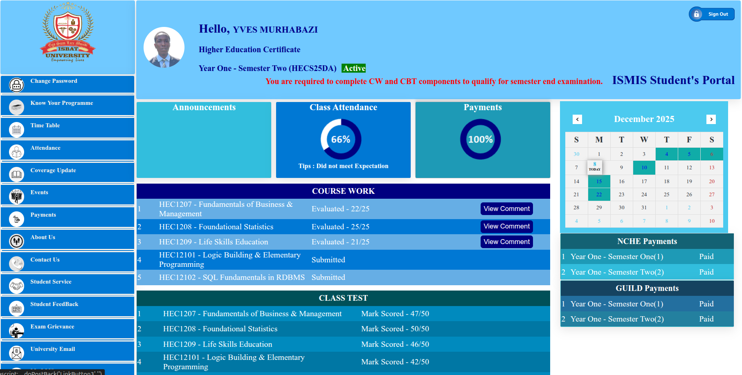

Slide 5
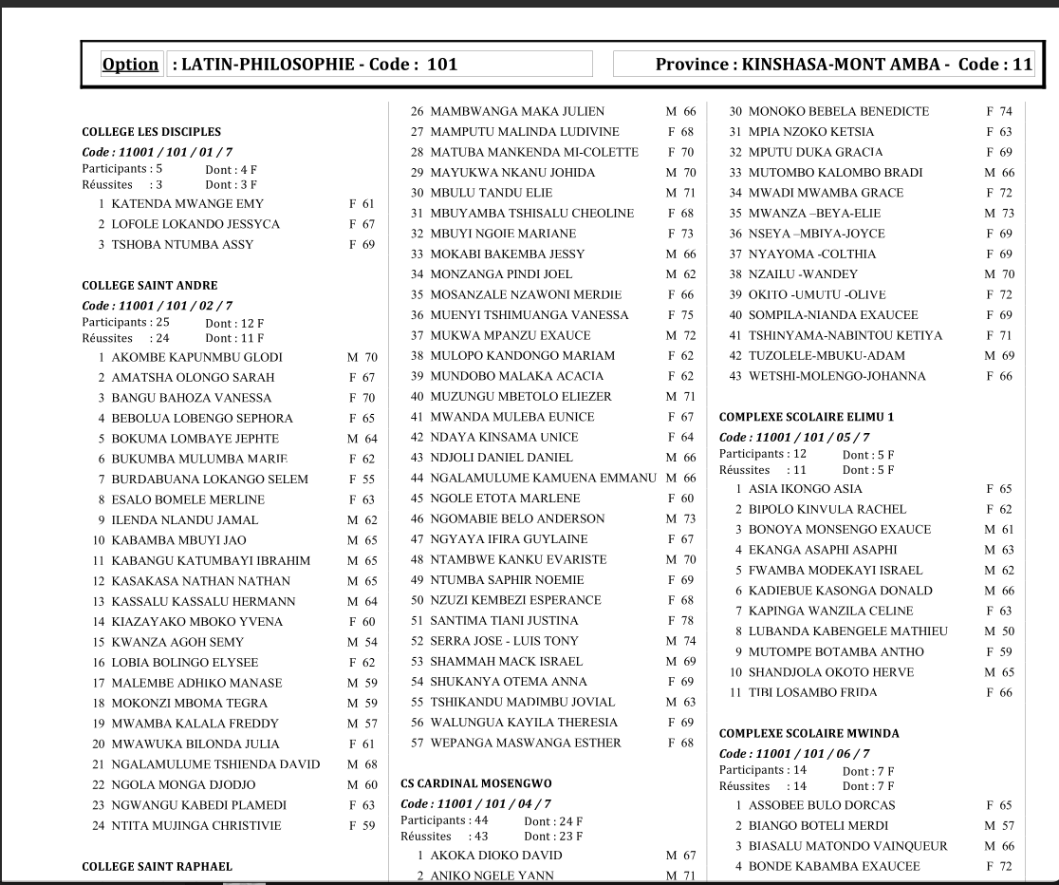

Slide 6
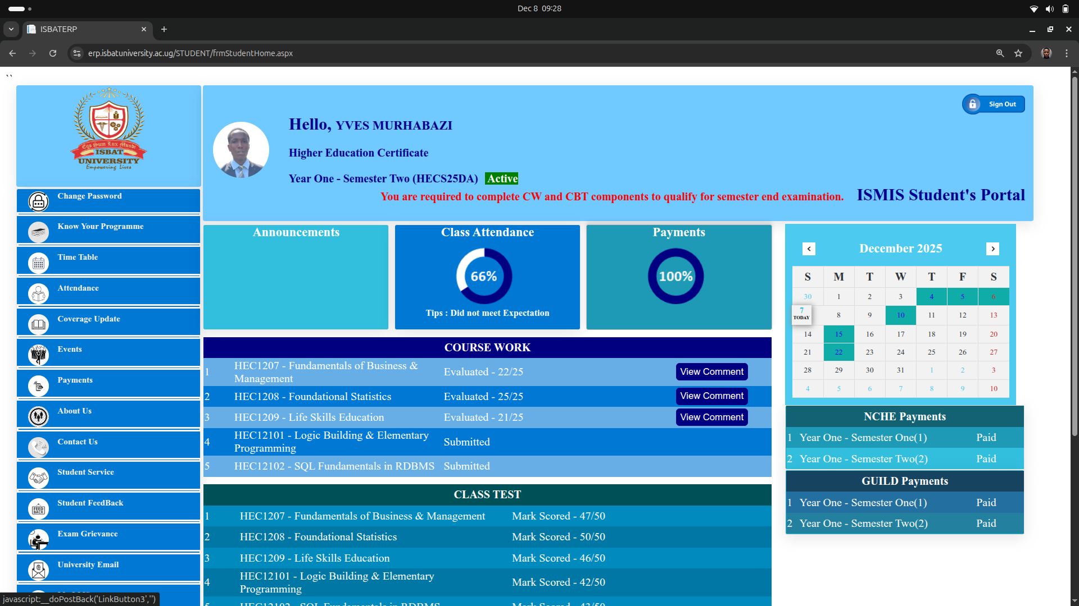
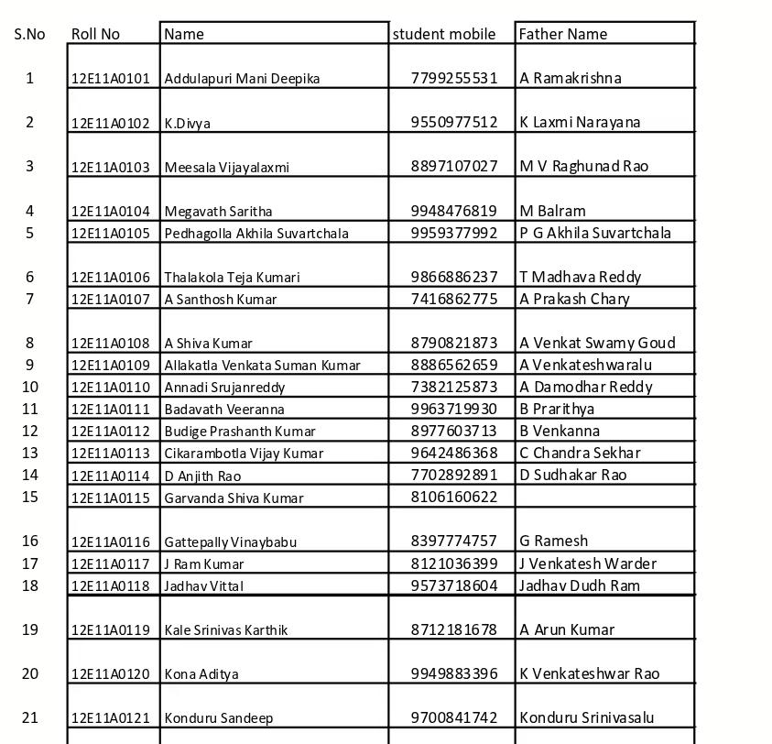
WHICH ONE DO YOU PREFER GUYS

Slide 7

Development of an Interactive Dashboard for School Performance Analysis Using EXETAT
Enhancing education insights through dynamic data visualization
Notes:
---

Slide 8
Title & Purpose
Notes:
---
This slide references information from the following file: https://isbat-my.sharepoint.com/personal/011250047_isbatuniversity_com/Documents/finaly.docx
Project Overview and Purpose

Slide 9

Project Overview and Purpose
Current Challenge
  EXETAT exam results are published as static PDFs, limiting accessibility and understanding for stakeholders.
Project Purpose
  To develop an interactive dashboard converting static exam data into dynamic, user-friendly visualizations.
Stakeholder Benefits
  Empowers parents, aids policymakers in monitoring trends, and promotes accountability in education.
Modernizing Education Data
  Bridges raw exam data and actionable insights to improve educational outcomes and equity in DRC.
Notes:
---
This slide references information from the following file: https://isbat-my.sharepoint.com/personal/011250047_isbatuniversity_com/Documents/finaly.docx
The project titled "Development of an Interactive Dashboard for School Performance Analysis Using National State Exam (EXETAT): A Case Study of the Ministry of Education in DRC" addresses a critical challenge in the Democratic Republic of Congo’s education system. Currently, the Ministry of Education publishes annual EXETAT exam results in static PDF tables, which are difficult for parents, policymakers, and other stakeholders to interpret. This lack of accessibility and usability limits transparency and informed decision-making. The purpose of this research is to design and develop an interactive dashboard that transforms these static results into dynamic, user-friendly visualizations. By doing so, the dashboard aims to empower parents to make evidence-based school choices, assist policymakers in monitoring performance trends, and promote accountability within the education sector. The solution leverages modern data analytics and visualization techniques to bridge the gap between raw examination data and actionable insights. Ultimately, this project seeks to modernize educational data management in the DRC, ensuring that stakeholders have the tools necessary to make informed decisions that improve educational outcomes and equity.

Slide 10
Methodology & Key Features
Notes:
---
This slide references information from the following file: https://isbat-my.sharepoint.com/personal/011250047_isbatuniversity_com/Documents/finaly.docx
Research Methodology and Dashboard Design

Slide 11
Research Methodology and Dashboard Design
Step | Description
Web Scraping | Automated collection of Palmarès reports from official websites
PDF Parsing | Extraction of school and student data into structured formats
Database Normalization | Organizing data into clean relational models using 1NF, 2NF, 3NF
Dashboard Design | Development of an interactive interface with KPIs, rankings, and filters
Notes:
---
This slide references information from the following file: https://isbat-my.sharepoint.com/personal/011250047_isbatuniversity_com/Documents/finaly.docx
The methodology for this project involved several technical steps to ensure accurate data extraction, processing, and visualization. First, web scraping techniques were employed to collect official Palmarès reports from the Ministry of Education’s website. These reports, which contain EXETAT results, were originally in PDF format, making them difficult to analyze. To address this, the second step involved PDF parsing, where data was extracted and converted into structured formats such as JSON. This structured data was then organized into a normalized relational database using principles of First, Second, and Third Normal Forms (1NF, 2NF, 3NF) to eliminate redundancy and ensure data integrity. Finally, the dashboard was developed using modern Python tools and designed to be interactive and user-friendly. Key features include summary metrics such as total schools, participants, and success rates; best student highlights; dynamic school ranking tables; and interactive filters for year, province, and option. The dashboard employs a clean visual hierarchy and color coding to enhance readability and ensure that critical information stands out. These features collectively enable stakeholders to analyze school performance trends effectively and make informed decisions.

Slide 12
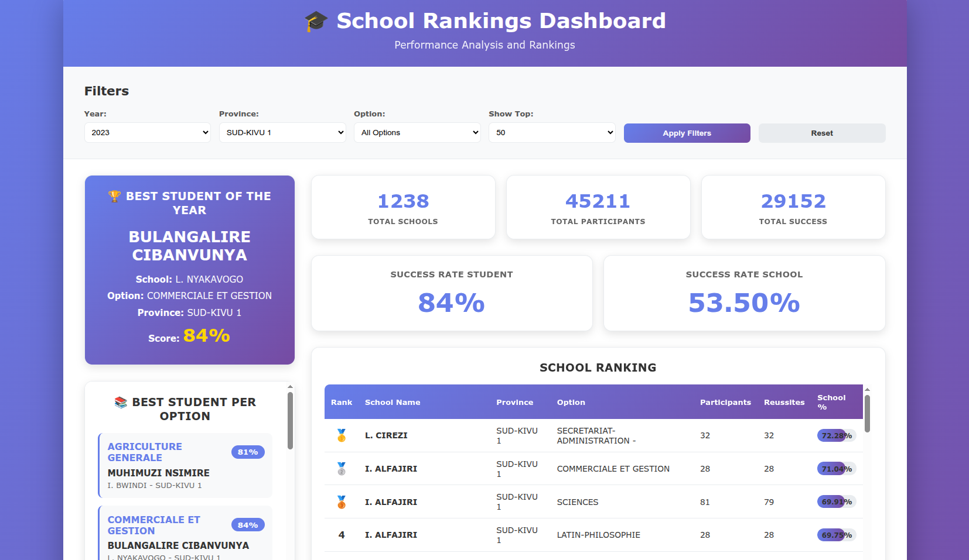

Slide 13
Limitation of the study
Limited Access to Historical EXETAT Data:
Data Inconsistencies:
Time Constraints:
Beginner-Level Design and Implementation:

